Slide 1


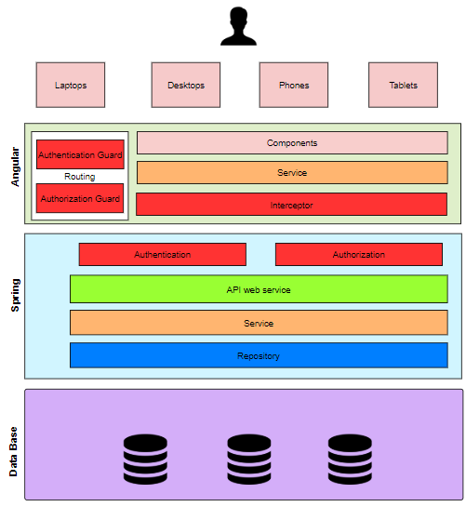
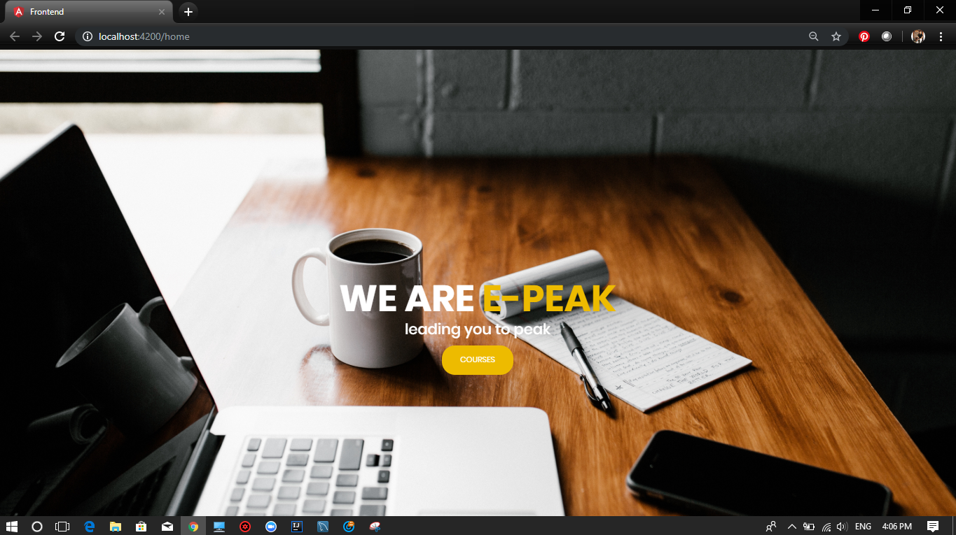
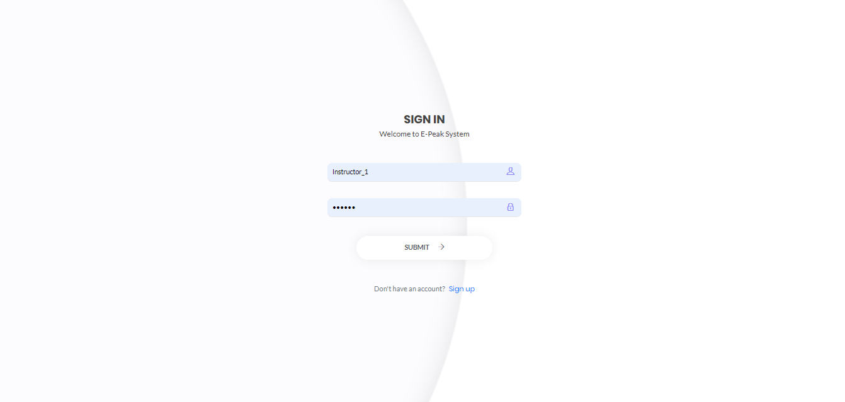
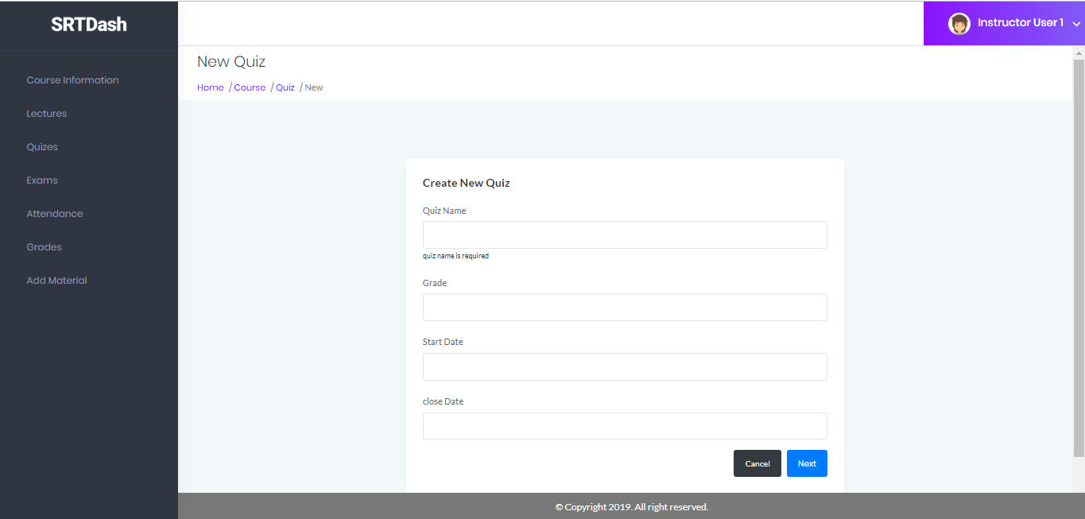

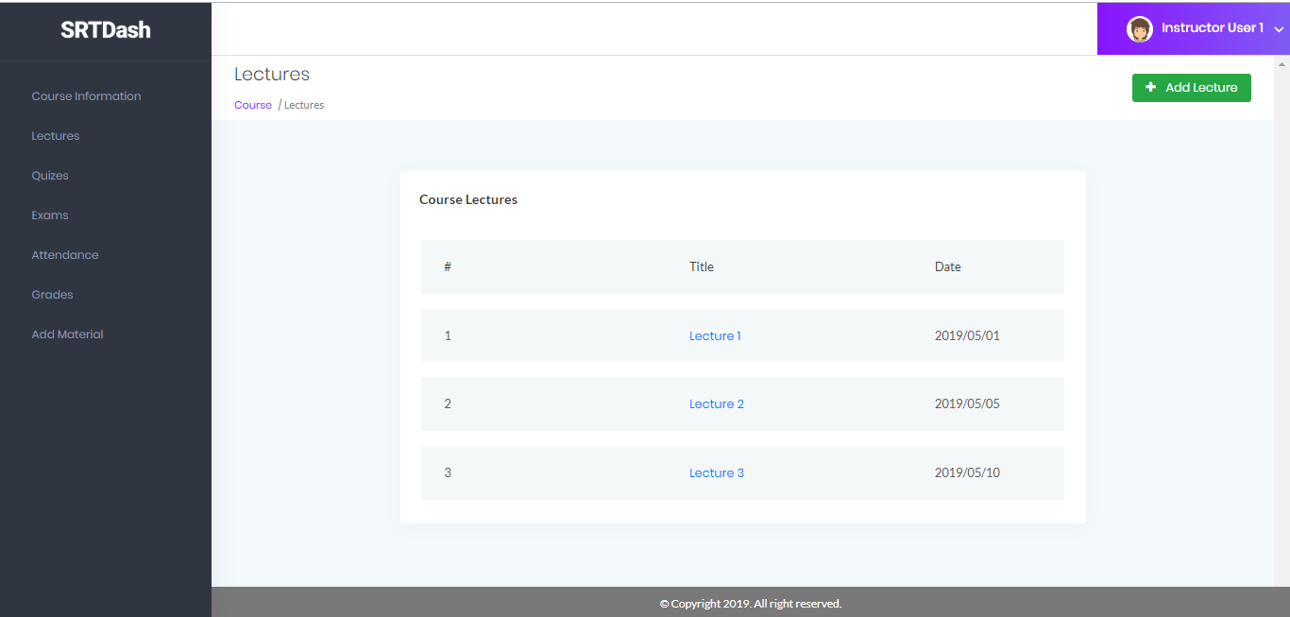





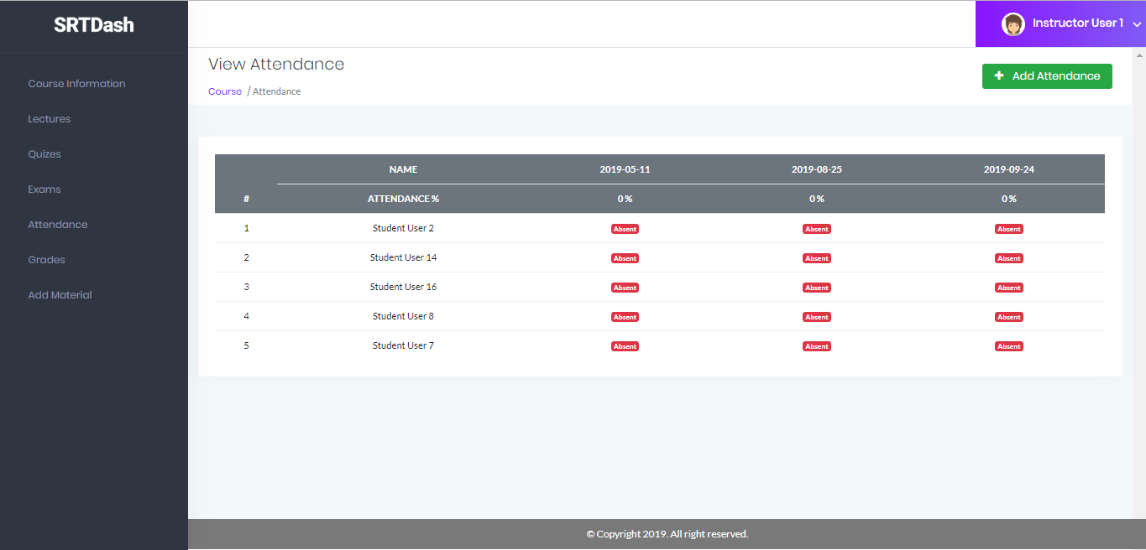
E-Peak
Course Management System for Academic and Practical Learning
Abanoob Fayez Kamal Mikhail, Ahmed Fathy Abd-Elfattah Hassan, Manar Elsayed Mohamed Ezzat, Hala Mahmoud Gouda Elsayed, Yara Abd -Elrahmaan Mahmoud Ali, Yousef Reda Saed El-Hadad.
Under Supervision of : Dr/Ahmed Taha
Faculty of Computers and Informatics
Benha University
Introduction
Technologies & Tools
Results
Conclusion
Architecture Diagram
Technologies:
Angular 6
Spring Boot
RESTful Web Service
Spring JDPC
MySQL
Tools:
Intellij
MySQL Server/workbench
Version control Repository (GitHub)
Tortoise SVN (Client)
Node js
JDK 8
The result of this Project is :
A web application with 3 roles or users each of them has some privileges in our course management system E-PEAK
For example the instructor role can create quiz on course with date and title and some questions which is automate correcting by the system.
At course list component the user can view all lectures on this course with some validations which no lecture can be available or see its content before its date which limited by course’s instructor.
Each lecture has attendance component which is responsible for taking students attendance.
In conclusion, the aim of the project is to help the students get over the traditional methods of learning and make them accustomed to the internet where the notes for their respective subjects are easily available. It provides an automation procedure of studying online. The implementation of this project helps both the students and the teachers. The teachers can upload their materials on to the website by using their unique ID and the students can gain access to these materials.
Technology is changing the way teacher teaches and learner learns. Earlier learning has only one option that is to go to school and learn, but today we have various options of learning whatever we want. Some of the modern options of learning include e-Learning, online learning, distance learning, blended learning, digital learning and virtual learning along with class room learning.
Course management system CMS is a collection of software tools providing an online environment for course interactions. A CMS typically includes a variety of online tools and environments. It is used very widely in universities and schools.
References
https://www.wrike.com/project-management-guide/faq/what-is-agile-methodology-in-project-management/
https://www.javatpoint.com/spring-JdbcTemplate-tutorial
https://www.baeldung.com/spring-jdbc-jdbctemplate
https://www.tutorialspoint.com/restful/restful_introduction.html
https://jersey.github.io/
https://tortoisesvn.net/about.html
https://en.wikipedia.org/wiki/Java_Development_Kit
https://www.tutorialspoint.com/angular6/angular6_overview.html
https://codecraft.tv/courses/angular/routing/router-guards/
https://www.tutorialspoint.com/spring_boot/spring_boot_introduction.htm
https://www.projectsmart.co.uk/project-management-time-estimates-and-planning.php.
https://en.wikipedia.org/wiki/Node.js.
https://www.guru99.com/introduction-to-mysql-workbench.html.
https://stackoverflow.com/questions/26777083/best-practice-for-rest-token-based-authentication-with-jax-rs-and-jersey
Objective
With the advent in technology and with the perpetual increase in the strength of the students and the number of departments in the educational institutions, it is laborious to exchange the study materials between the students and the faculties.
In most schools and universities, different teachers and professors overwhelm students with many education sites where they upload the resources of their subjects. Student find it hard to look for materials, or announcements.
The main objective is to help the students get over the traditional methods of learning and make them accustomed to the internet where the notes for their respective subjects are easily available. It provides an automation procedure of studying online. The implementation of this project helps both the students and the teachers. The teachers can upload their materials on to the website by using their unique ID and the students can gain access to these materials.
Acknoledgements
Achieving any kind of success in our project won’t happen without the help of many people around us. First we thank God for his blessings in our life. We would like to thanks our families, friends and doctors for being always
there for us and for helping us during our project and study time.
For our Faculty instructors, doctors and colleagues saying thank you is not enough for helping us through our years of studying and learning everything new, we hope you all will always give away science without asking for return.
We would like to thank and express our gratitude for our supervisor, Dr/Ahmed Taha for his encouragement, guidance, patience and support during our project starting from the beginning until putting the final highlights for our project, thank you Dr/Ahmed for always listening for us and our opinion and for always wishing us the best.
Also we would like to thank Eng/ Mostafa Samy for all his efforts and patience with us.

